Slide 1
MAFS 6010Z-L1 Artificial Intelligence in Fintech Warm-up Project: Home Credit Default Risk Analysis Using Machine Learning Models
Wenjing XUE 21028457
Hongxi CHEN 21025223
Guobin DING 21018385
Guan QIAO 21017331
Teacher: Professor Yuan YAO
Hong Kong University of Science and Technology

Slide 2
Table of Content
Restatement of Problems
Exploratory Data Analysis
Data Processing
Feature Selection Engineering
Model Construction & Comparison

Slide 3
Restatement of Problems
What is the profiling of the customer base?
How those attributes influence the probability of default?
How to use models to accurately predict whether the customer would default or not?

Slide 4
Exploratory Data Analysis
There are totally 307,511 pieces of clients’ information and 221 features.
Main Dataset: application_train
SK_ID _CURR | TARGET | NAME_ CONTRACT_TYPE | CODE _GENDER | FLAG _OWN _CAR | FLAG _OWN _REALITY | CNT _CHILDREN | AMT _INCOME _TOTAL | AMT _CREDIT | AMT _ANNUITY
100002 | 1 | Cash loans | M | N | Y | 0 | 202500 | 406597.5 | 24700.5
100003 | 0 | Cash loans | F | N | N | 0 | 270000 | 1293502.5 | 35698.5
100004 | 0 | Revolving loans | M | Y | Y | 0 | 67500 | 135000.0 | 6750.0
100006 | 0 | Cash loans | F | N | Y | 0 | 135000 | 312682.5 | 29686.5
100007 | 0 | Cash loans | M | N | Y | 0 | 121500 | 513000.0 | 21865.5
Source: Kaggle
Notes:
In order to research, we find relevant dataset about bank customer information from Kaggle,
10127 pieces information of bank customers.
21 attributes, such as age, income, marital status and so on.
Here 16 of them are numerical and 5 of them are categorical.

Slide 5
Exploratory Data Analysis- Numerical Variables
28 numerical variables
Customer Base Description:
Total Income is $[25,650, 117,000,000] (Average $168,798).
Credit is $[402,491, 4,050,000].
Annuity is $[1,615.50, 258,025.50].
Close to normal distribution and at rational range
Outliers
Notes:
Large difference between customers
插图

Slide 6
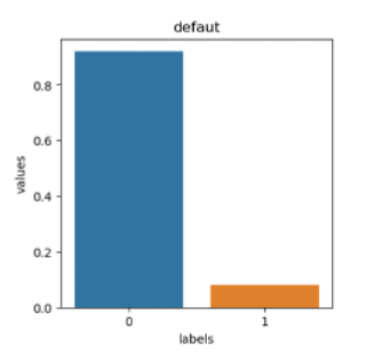
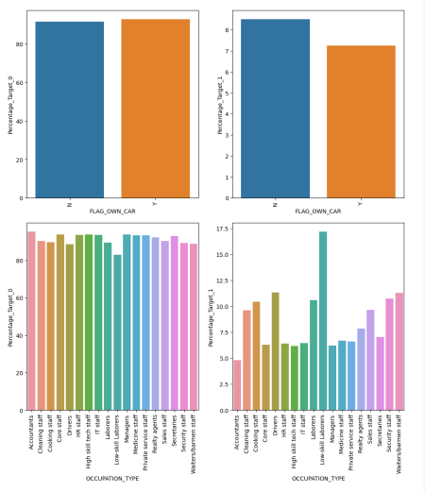
Exploratory Data Analysis- Categorical Variables
Single-category
Multi-category
Imbalance !

Slide 7
Data Processing-
One Hot Encoder, Label Encoder & Feature Construction
One Hot Encoder & Label Encoder
Label Encoder
Two-category Data
Focus Categorical Data
Multi-category Data
One-hot Encoder
Feature Construction
More economical meanings and rational -- Construct variables
New linear-combined variables
Rational-combined variables

Slide 8
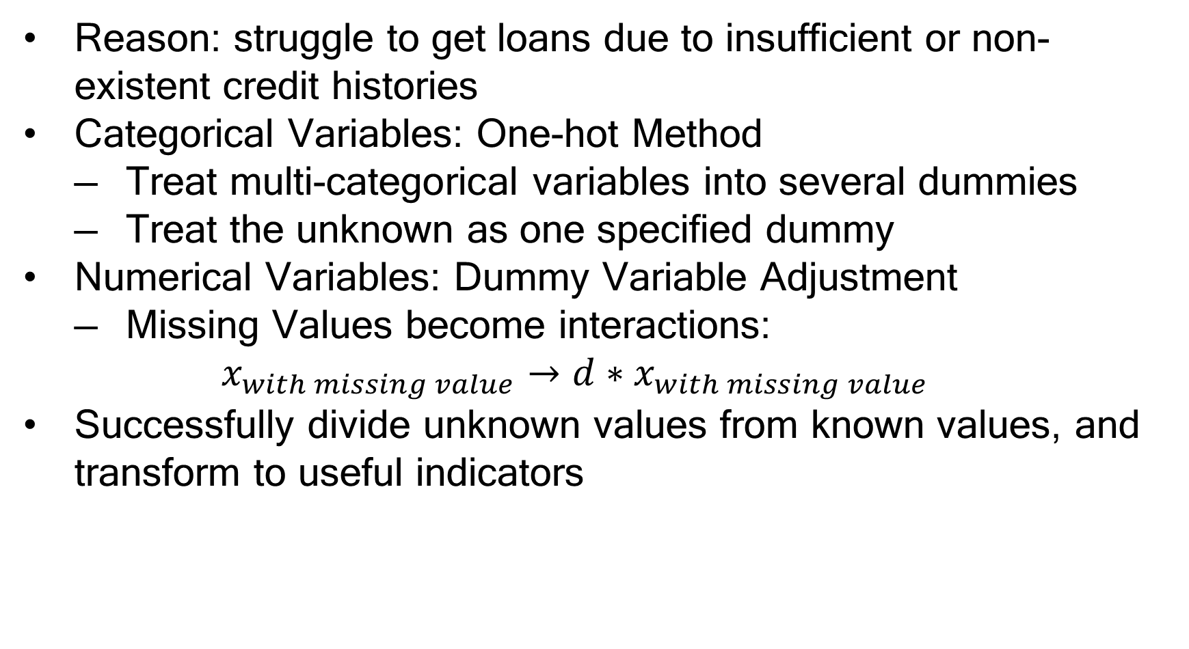
Data Processing-
Missing Value Pudding
Reason: struggle to get loans due to insufficient or non-existent credit histories
Categorical Variables: One-hot Method
Treat multi-categorical variables into several dummies
Treat the unknown as one specified dummy
Numerical Variables: Dummy Variable Adjustment
Missing Values become interactions:
$$x_{with missing value}→d∗x_{with missing value}$$
Successfully divide unknown values from known values, and transform to useful indicators

Slide 9
Data Processing-
Synthetic Minority Oversampling Technique
Phenomenon: Target is unbalanced.
Cannot fully depict figures of default one.
Synthetic Minority Oversampling Technique [SMOTE]:
“was proposed for enlarging the region of minority class by generating synthetic instances in feature space” (Zhu et. al.,2017).
Notes:
插图

Slide 10
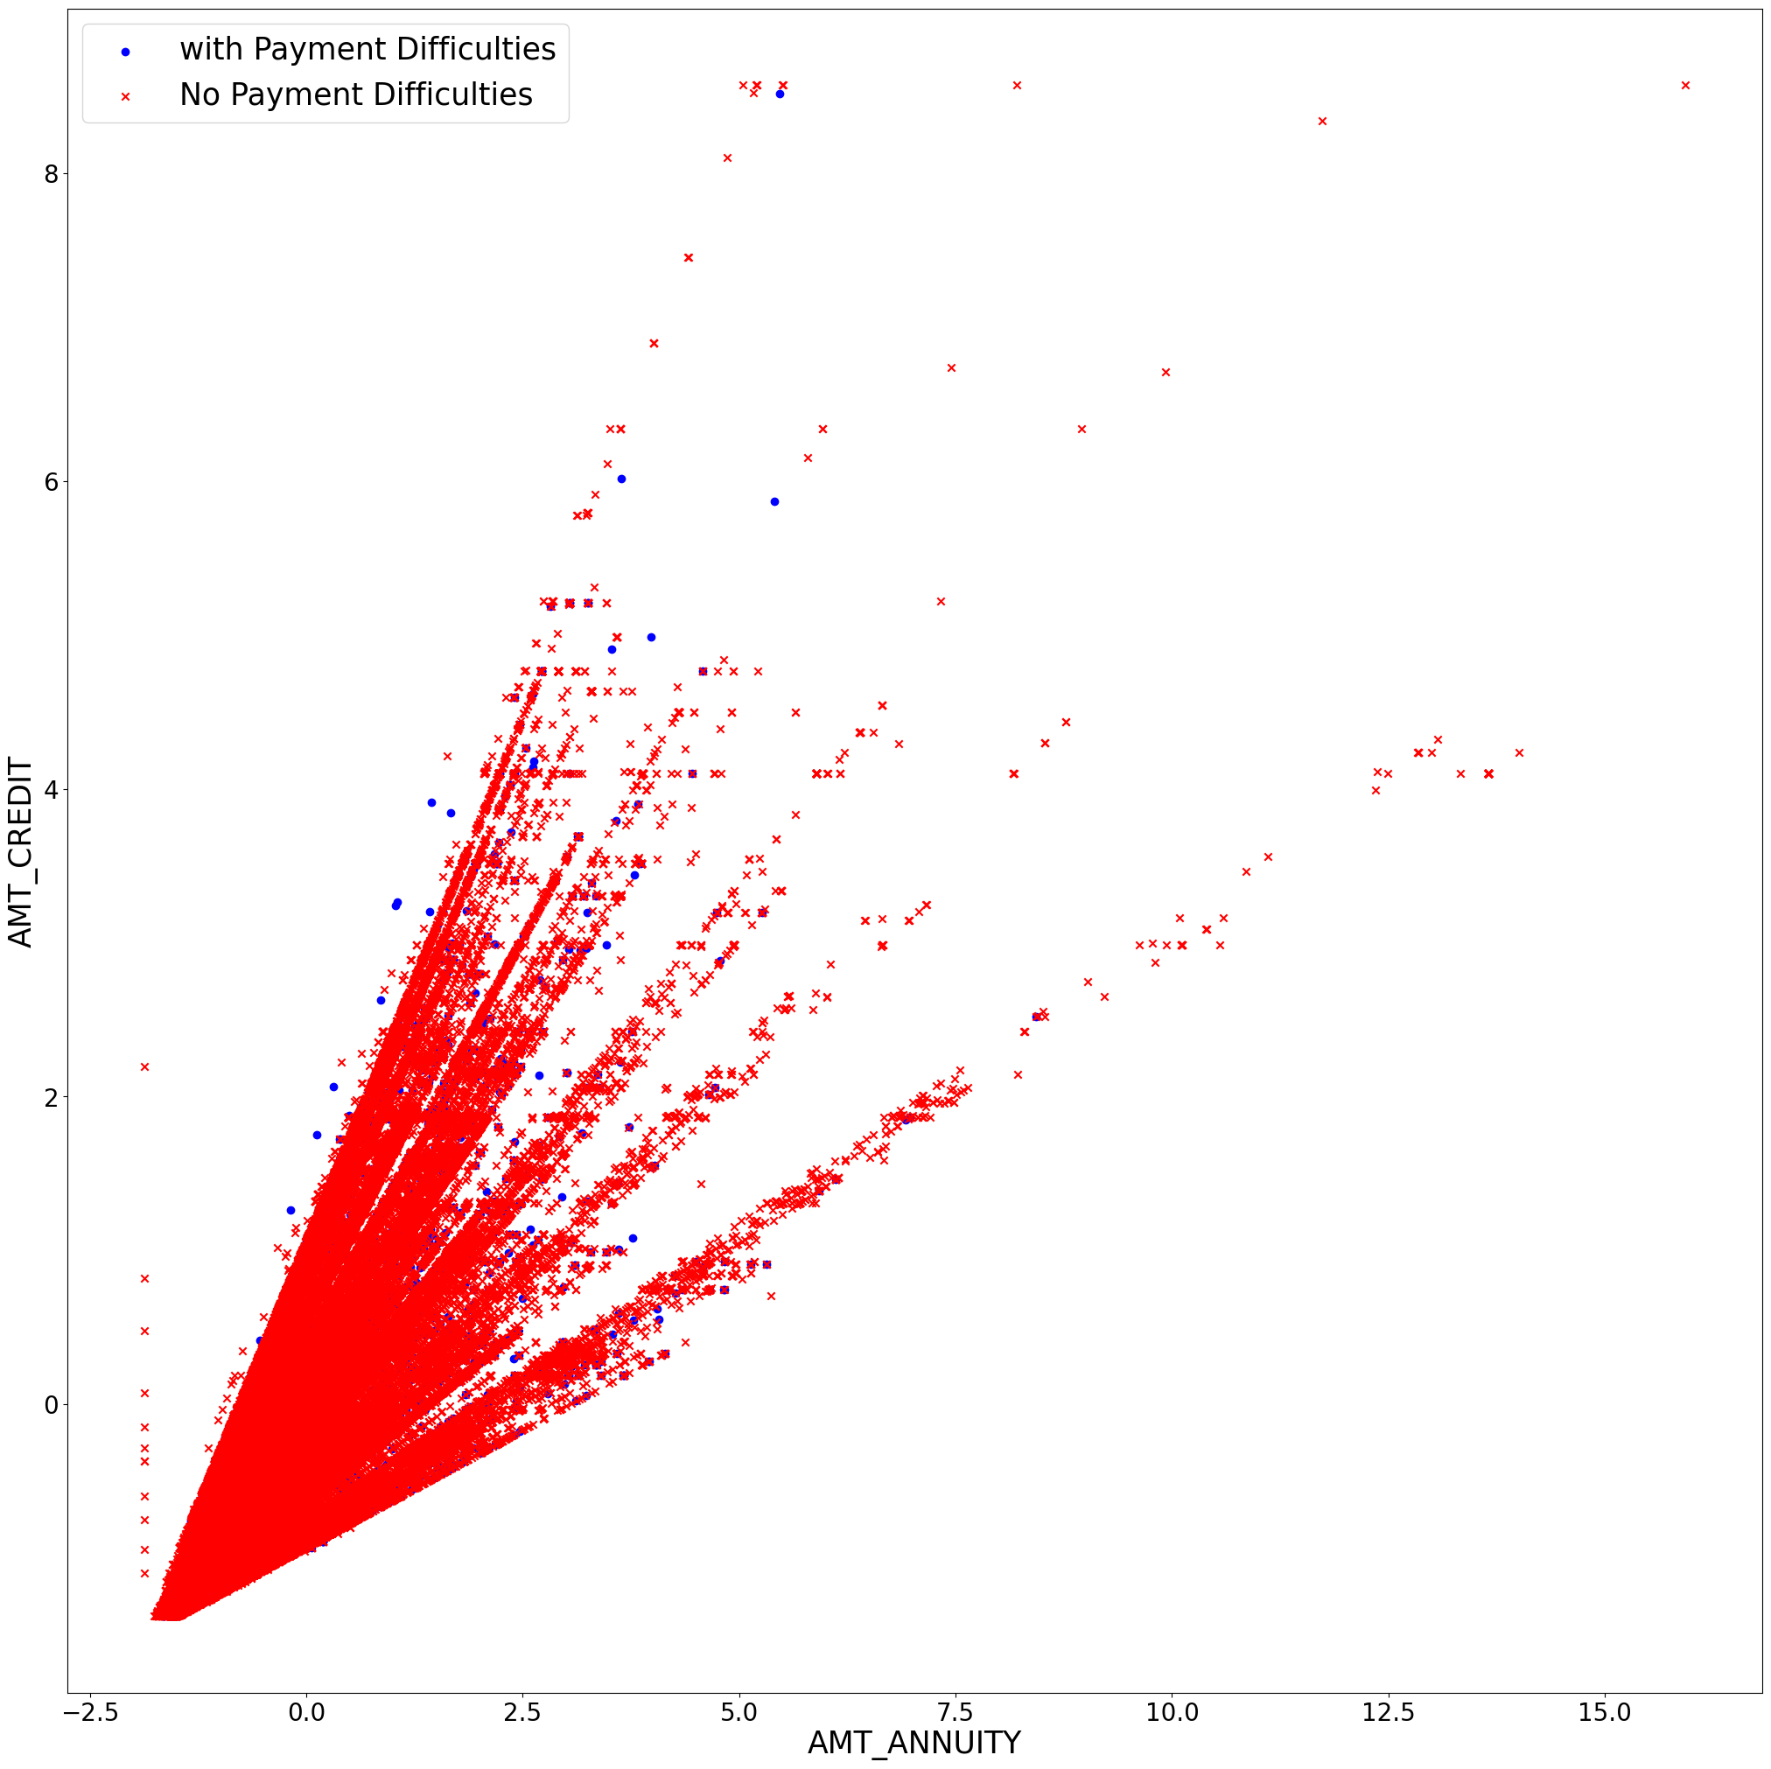
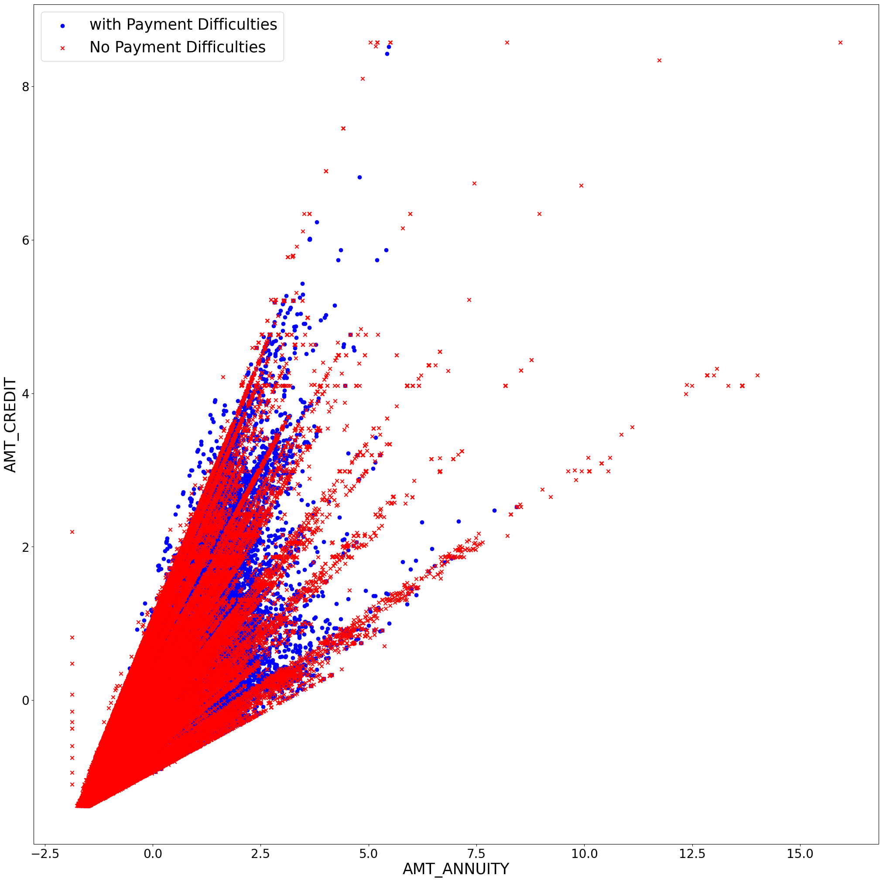
Data Processing-
Synthetic Minority Oversampling Technique
Notes:
插图

Slide 11
Feature Selection Engineering-
Data Leakage Processing
May lead to:
Great performance in the training set
Poor in testing set
Solution:
Drop features with high causality
Based on experts’ research
Notes:
插图

Slide 12
Feature Selection Engineering-
Principal Components Analysis [PCA]
Treat categorical variables
Goal:
Map the high-dimensional data into low-dimensional space
Try to fully depict characteristics
Reduce dimension to 10
Notes:
插图
Explained variance ratio is almost 50%
not very high score, as considering correlations, they are not highly correlated (Figure 11). Thus, we think those principal components are rational to select for this research.

Slide 13
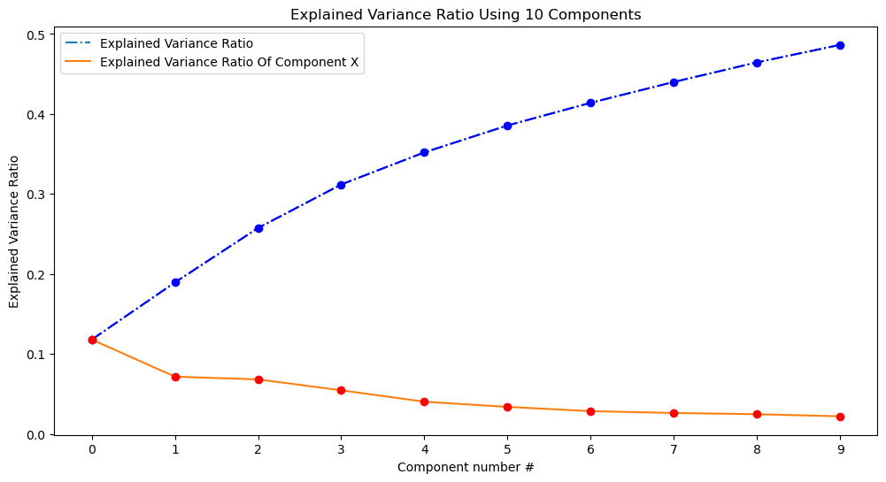
Feature Selection Engineering-
Principal Components Analysis [PCA]
Notes:
插图
Explained variance ratio is almost 50%
not very high score, as considering correlations, they are not highly correlated (Figure 11). Thus, we think those principal components are rational to select for this research.

Slide 14
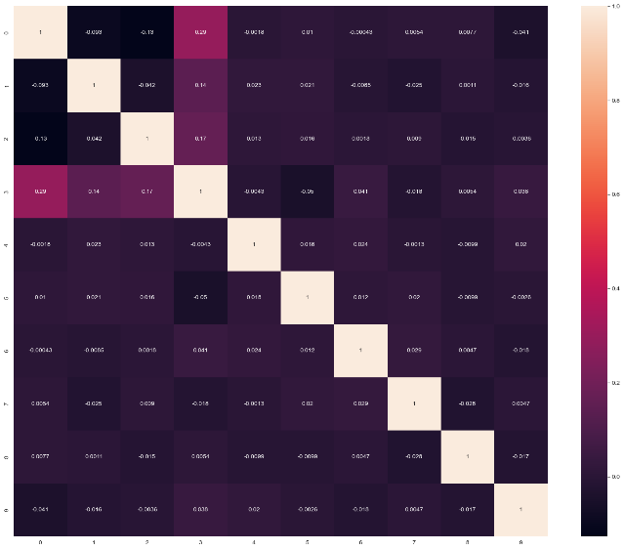
Feature Selection Engineering-
Principal Components Analysis [PCA]
Notes:
Even though it is not very high score, as considering correlations, they are not highly correlated (Figure). Thus, we think those principal components are rational to select for this research.

Slide 15
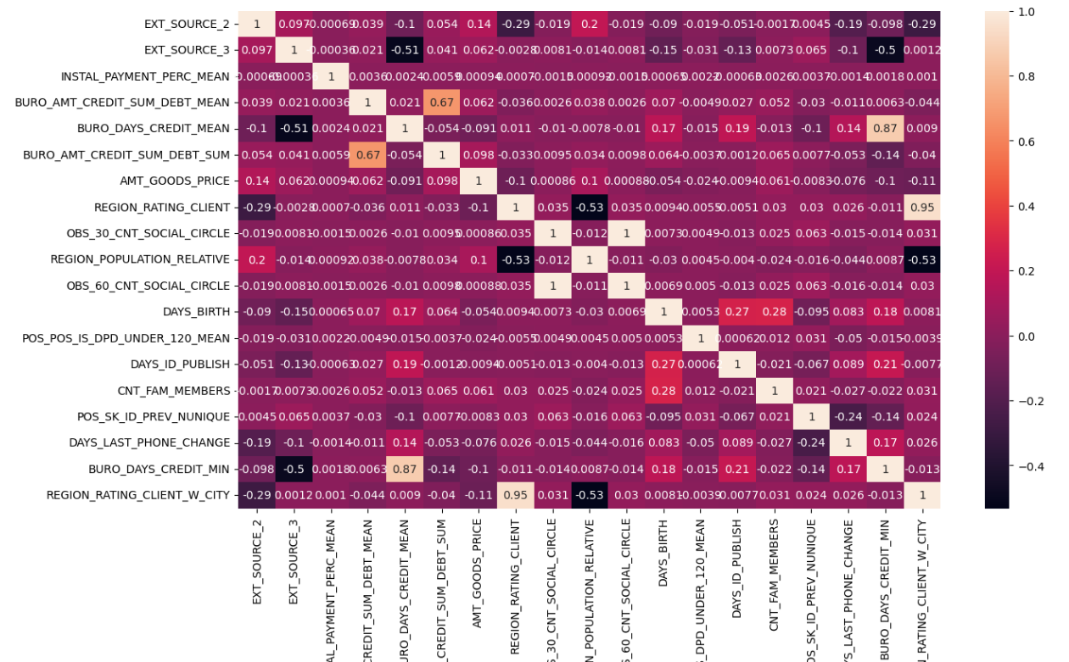
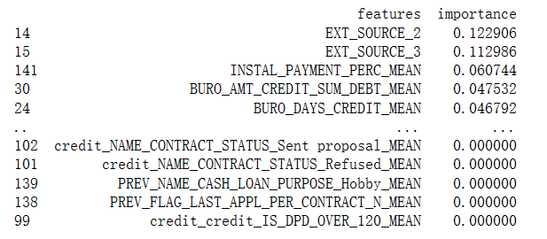
Feature Selection Engineering-
Random Forest & Pearson Correlation Coefficient
Random Forest
Pearson Correlation Coefficient

Slide 16
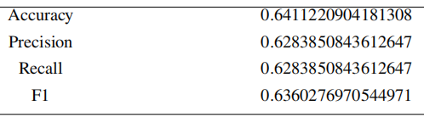
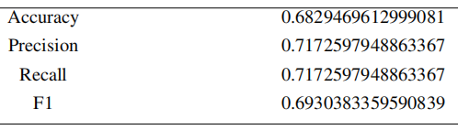
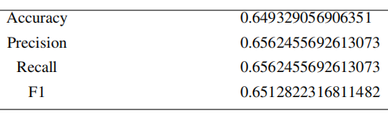
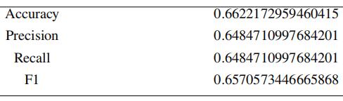
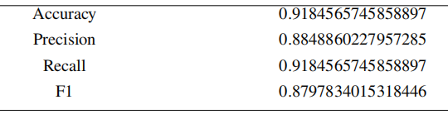
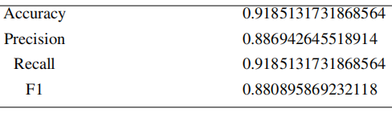
Model Construction & Comparison
Logistic regression model
K-Nearest Neighbors
Random Forest
Support Vector Machine
Gaussian Naive Bayes
Gradient Boosting Decision Tree

Slide 17
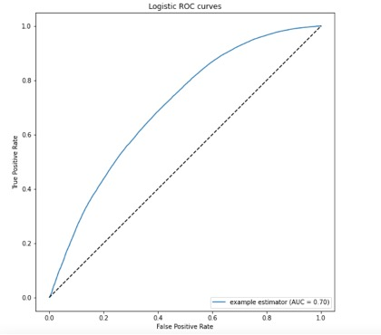
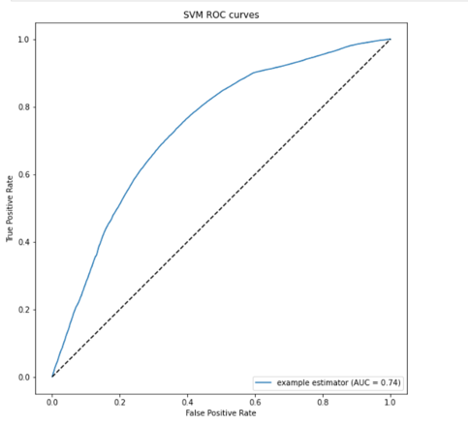
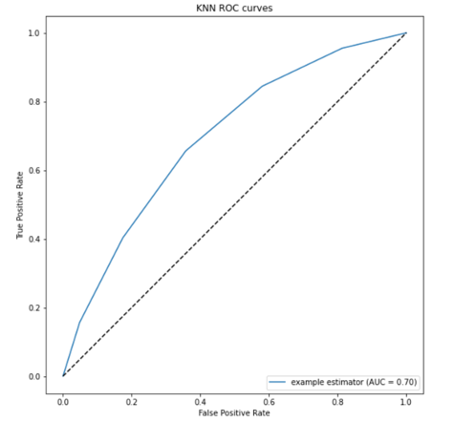
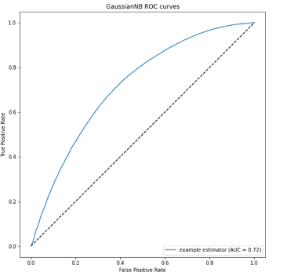
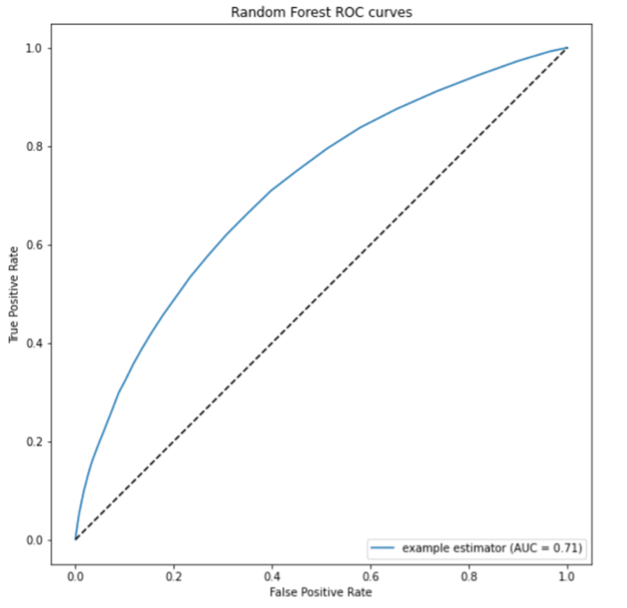
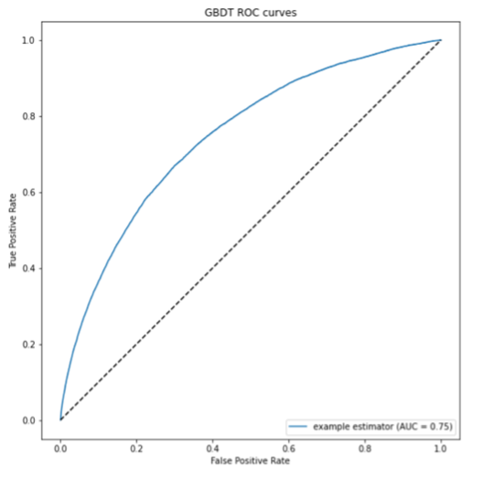

Slide 18
Model Prediction
Random Forest:
Using max_depth to 11, min_samples_split to 10, and n_estimators to 1000.
With these adjustments, the Kaggle score for Random Forest reached 0.7189.
GBDT:
Using n_estimators to 100 and learning_rate to 0.1
With these parameter adjustments, the Kaggle score for GBDT improved to 0.731.
Notes:
Because we want to construct model that accurately estimate whether customers get churned, we select attributes that are highly correlated with the target “Churn”. Hence, we select Total_Trans_Ct, Total_Ct_Chng_Q4_Q1 and Total_Relationship_Count.
we would construct models through Total_Trans_Ct, Total_Ct_Chng_Q4_Q1, Total_Relationship_Count and principal components.

Slide 19
Conclusion
GBDT is better than random forest.
This project holds significant implications for individuals with limited or no credit history.
The features identified as highly significant during our data processing stage can empower customers to take proactive steps to improve their credit scores, allowing them to access lower interest rates and higher credit limits.
Notes:
Because we want to construct model that accurately estimate whether customers get churned, we select attributes that are highly correlated with the target “Churn”. Hence, we select Total_Trans_Ct, Total_Ct_Chng_Q4_Q1 and Total_Relationship_Count.
we would construct models through Total_Trans_Ct, Total_Ct_Chng_Q4_Q1, Total_Relationship_Count and principal components.

Slide 20
Reference
Addo, P. M., Guegan, D., & Hassani, B. (2018). Credit risk analysis using machine and deep learning models. Risks (Basel), 6(2), 1–20. https://doi.org/10.3390/risks6020038
Bowles, M. (2015). Machine learning in python: essential techniques for predictive analysis. Wiley. Liang, W., Luo, S., Zhao, G., Wu, H. (2020). Predicting Hard Rock Pillar Stability Using GBDT, XGBoost, and LightGBM Algorithms. Mathematics (Basel), 8(5), 765–. https://doi.org/10.3390/math8050765
Netzer, O., Lemaire, A., & Herzenstein, M. (2019). When Words Sweat: Identifying Signals for Loan Default in the Text of Loan Applications. Journal of Marketing Research, 56(6), 960–980. https://doi.org/10.1177/0022243719852959
Shen, J. (2020). Secure Training of Random Forest Classifiers over Continuous Data. Thesis (Master’s)–University of Washington, 2020.
Singhal, V., Chaudhary, Y., Verma, S., Agarwal, U., & Sharma, M. P. (2022). Breast Cancer Prediction using KNN, SVM, Logistic Regression and Decision Tree. International Journal for Research in Applied Science and Engineering Technology, 10(5), 1877–1881. https://doi.org/10.22214/ijraset.2022.42688
Swiderski, B., Kurek, J., & Osowski, S. (2012). Multistage classification by using logistic regression and neural networks for assessment of financial condition of company. Decision Support Systems, 52(2), 539–547. https://doi.org/10.1016/j.dss.2011.10.018
Tsai, C.-F., & Chen, M.-L. (2010). Credit rating by hybrid machine learning techniques. Applied Soft Computing, 10(2), 374–380. https://doi.org/10.1016/j.asoc.2009.08.003
Zhou, Z.-H. (2021). Machine learning. Springer. Zhu, T., Lin, Y., & Liu, Y. (2017). Synthetic minority oversampling technique for multiclass imbalance problems. Pattern Recognition, 72, 327-340. https://doi.org/10.1016/j.patcog.2 017.07.024

